Slide 1
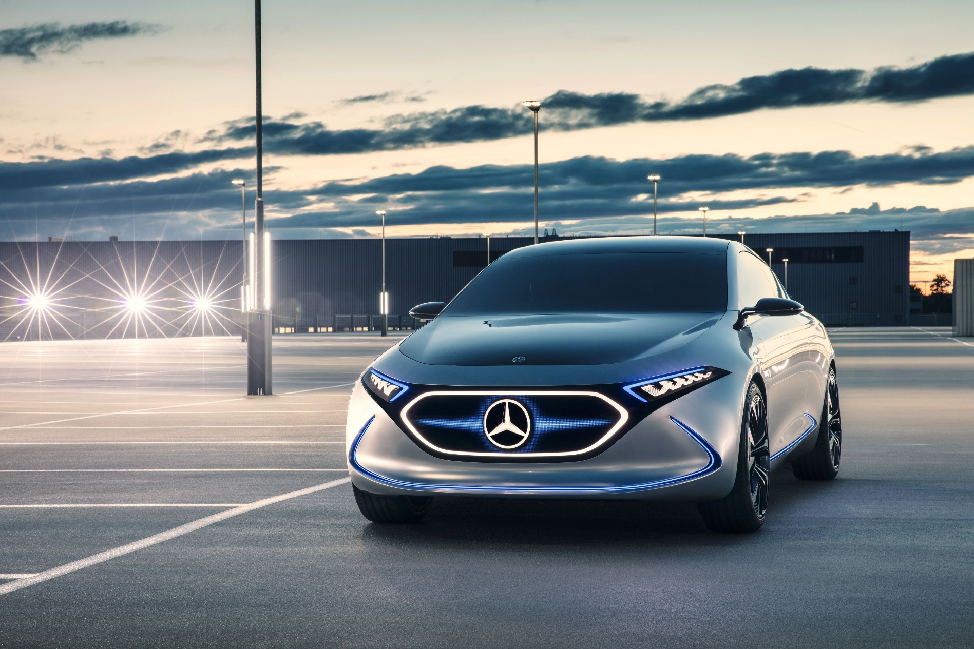
PAK-EV
Electric Car Manufacturing Company

Slide 2
Table of contents
01.
02.
Communication Goals
Stakeholders
04.
03.
Avenues
Differentiation
What are the goals that we want to achieve?
Who are our stakeholders and target audience.
05.
Achieves
Avenues through which content willl be distributed?
How are we going to create diiferentiation?
What we want to achieve?

Slide 3
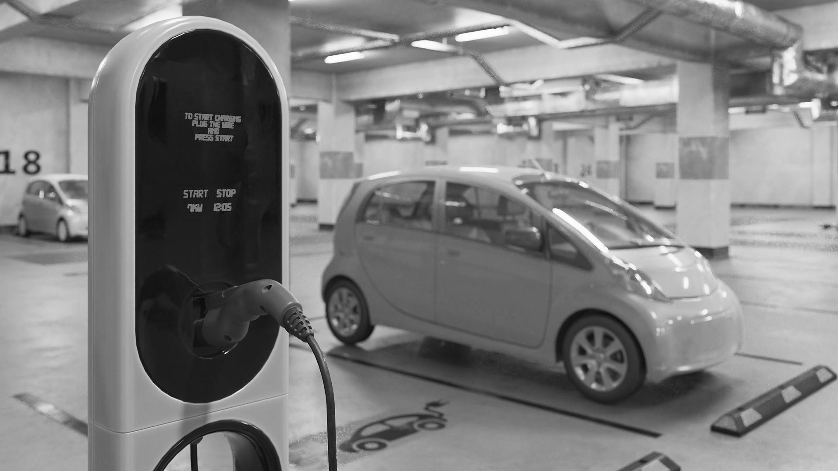
Communication Goals

Slide 4
—William J. Mitchell
“Imagine a kind of system where you have lightweight electric vehicles relatively small battery capacity, and then picking up charge wherever they park. You never have to worry about filling up your car.”

Slide 5
COMMUNICATION GOALS
GOAL 3
Achievement of goal number 2 will help to generate profit for the company to grow
GOAL 1
To make EV that is cheap and has international quality standard
GOAL 2
Every Pakistani can afford EVs so that environment pollution can be minimized

Slide 6
Why Electric Car?
No pollution
Efficiency
Go green
Save money

Slide 7


